Slide 1
PROGRAMMING LANGUAGE CLASSIFICATION

Slide 2
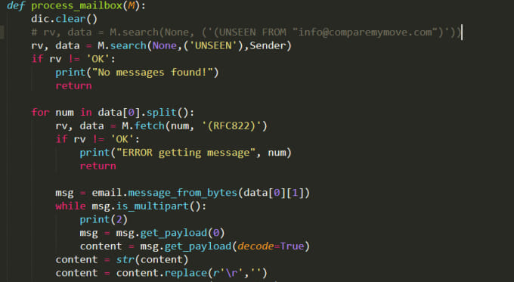
SOURCE CODE

Slide 3
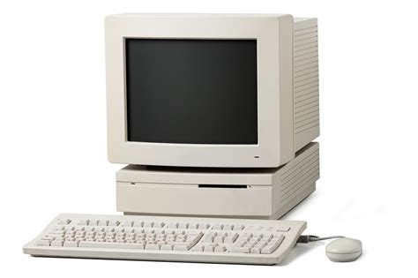
YOUR PC

Slide 4
YOUR PC
I don’t know your language.

Slide 5
YOUR PC
I know machine language.

Slide 6
YOUR PC
I know machine language.
101011010010101010100000101

Slide 7

I need to
sent a
email
INPUT
100101010101010101010001011100110110110100010111110010011001
OUTPUT
Email has been sent

Slide 8
YOU
It is very difficult for me to code like this.

Slide 9
YOU
I will use assembly language.
It is very difficult for me to code like this.

Slide 10
ASSEMBLER
Program to translate assembly language to machine language.

Slide 11

ASSEMBLY LANGUAGE
mov eax, 12
mov ebx, 18
add eax, ebx
Show ans
TRANSLATOR
1001010010101010101010101
YOU
ASSEMBLER
OUTPUT
30

Slide 12
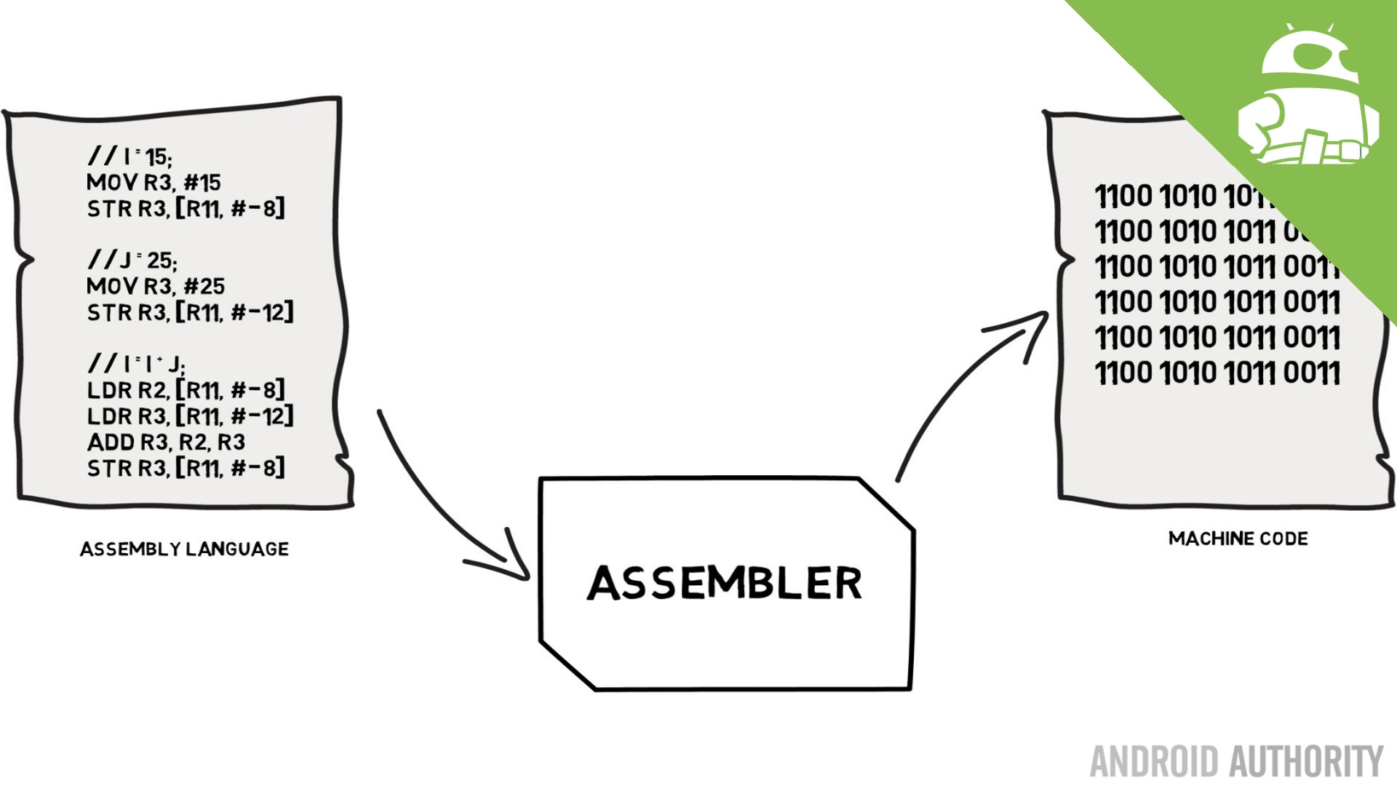
ASSEMBLY LANGUAGE

Slide 13
YOU
I will use high level language.
It is very difficult for larger programs.

Slide 14
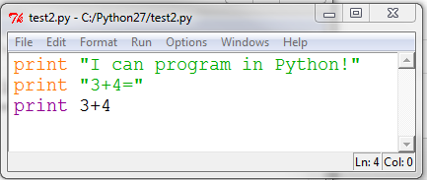
HIGH LEVEL LANGUAGE

Slide 15
PROGRAMMING LANGUAGE
LOW LEVEL LANGUAGE
HIGH LEVEL LANGUAGE
Eg: Python,C,C++
MACHINE LANGUAGE
ASSEMBLY LANGUAGE

Slide 16
HIGH LEVEL LANGUAGE
print(2+3)
TRANSLATOR
1001010010101010101010101
YOU
OUTPUT
5

Slide 17
TRANSLATOR FOR HIGH LEVEL LANGUAGE
1. INTERPRETER
2. COMPILER

Slide 18
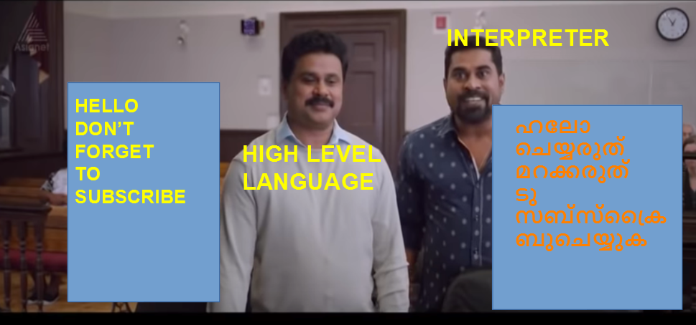
INTERPRETER

Slide 19
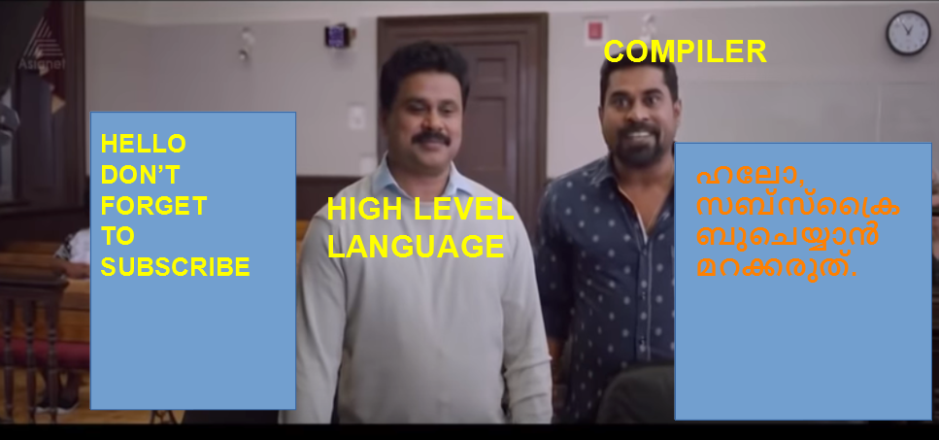
COMPILER

